Slide 1


Citizen Science
Thank You
Prof. Joseph Roche
Associate Dean of Research
Trinity College Dublin
JosephRoche.ie/EssentialSkills
@ScienceTCD

Slide 2

“professionals themselves have shown signs recently
of a loss of confidence in their claims to
extraordinary knowledge” (p.5)
Schön, D. A. (1983). The reflective practitioner:
How professionals think in action (Vol. 5126). Basic books.

Slide 3
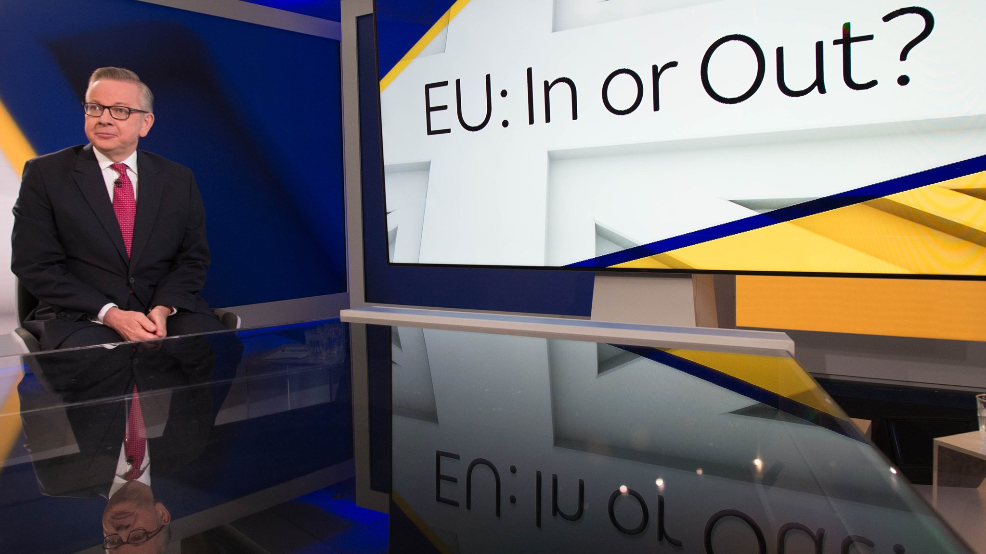
“people in this country have had enough of experts”
Mance, H. (2016, June 3). Britain has had enough of experts, says Gove.
Financial Times. Retrieved from https://www.ft.com

Slide 4
What can we, as researchers, do to become more aware of citizen science in our professional practice?

Slide 5

Reflective Practice

Slide 6
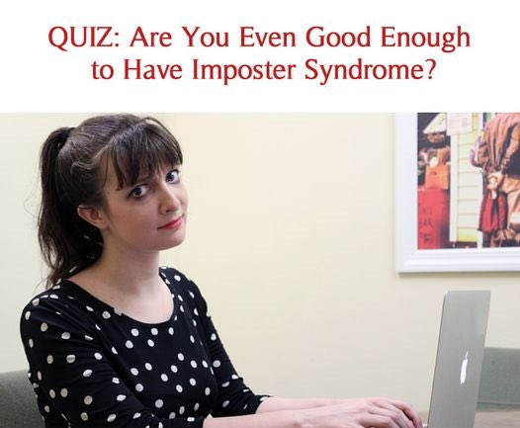

Slide 7
Reflection:
Self-observation and self-evaluation
(surface-level)

Slide 8
Critical Reflection:
Deeper analysis of personal actions within wider socio - politico - historical - economic - cultural contexts

Slide 9
“critical reflection calls into question the power relationships that allow, or promote, one particular set of practices over others” (p. 294)
Brookfield, S. (2009).
The concept of critical reflection: Promises and contradictions.
European Journal of Social Work, 12(3), 293-304.

Slide 10
“One of the key emerging recommendations is to align educational learning outcomes with citizen science project goals at the planning stage of the project using co-creation approaches to ensure issues of accessibility and inclusivity are paramount throughout the design and implementation of every project.
Only then can citizen science realise its true potential to empower citizens to take ownership of their own science education and learning.” (p. 1)
Roche, J., Bell, L., Galvão, C., Golumbic, Y. N., Kloetzer, L., Knoben, N., Laakso, M., Lorke, J.,
Mannion, G., Massetti, L., Mauchline, A., Pata, K., Ruck, A., Taraba, P., & Winter, S. (2020).
Citizen Science, Education, and Learning: Challenges and Opportunities.
Frontiers in Sociology, 5(613814), 1-10. DOI: 10.3389/fsoc.2020.613814

Slide 11
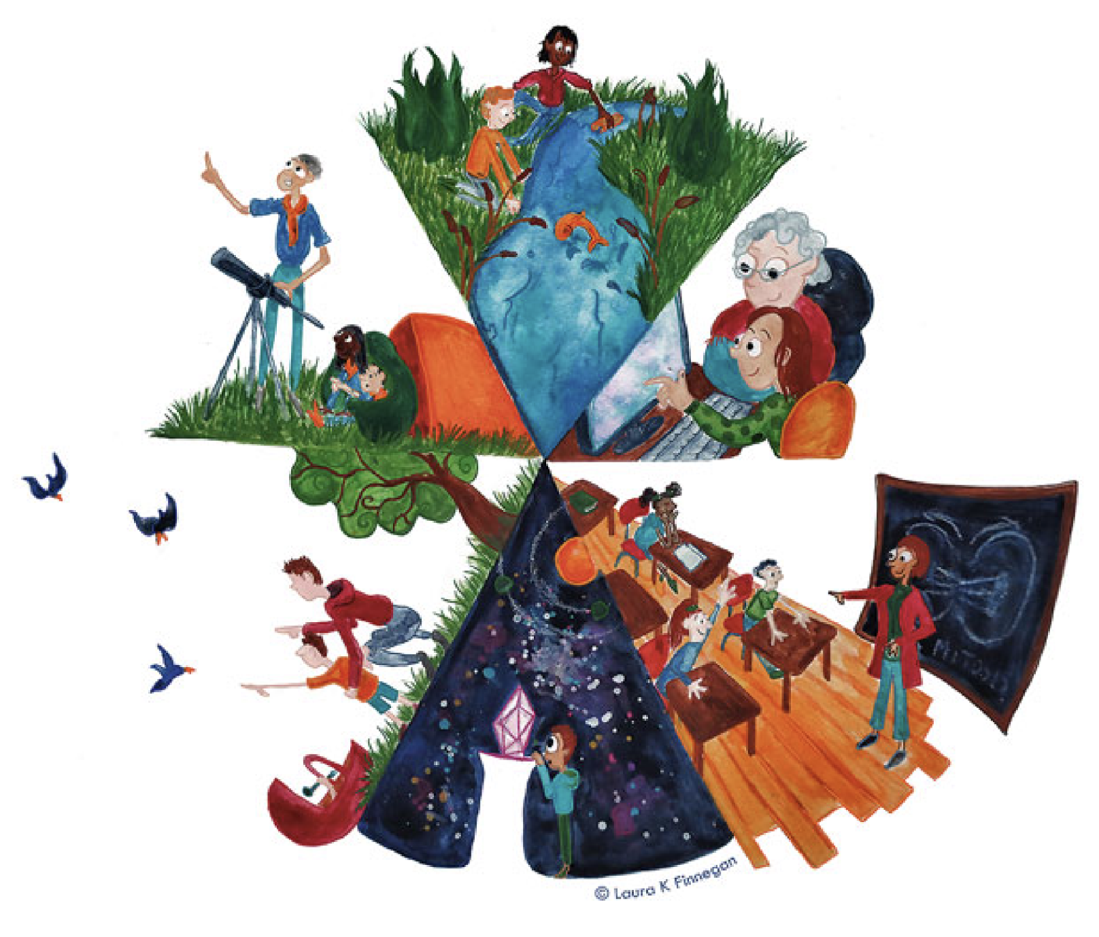
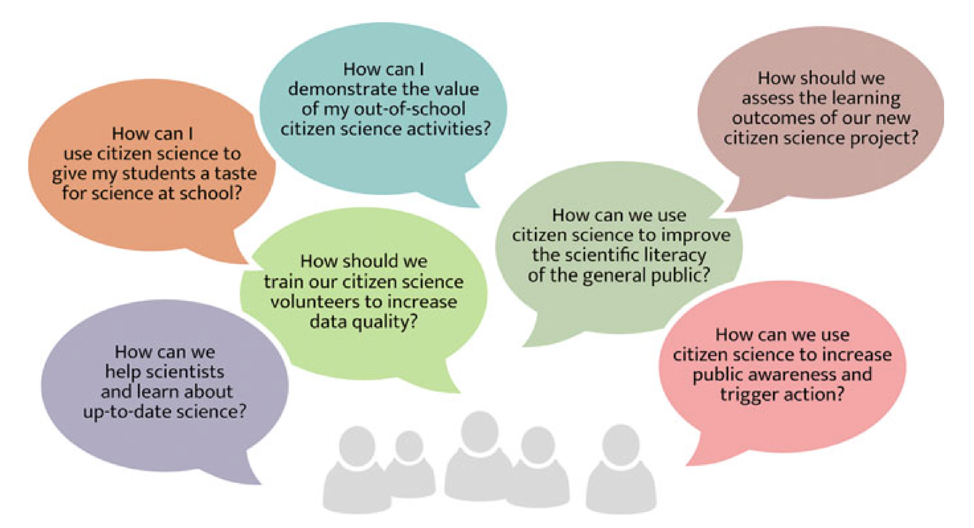
Kloetzer, L., Lorke, J., Roche, J., Golumbic, Y., Winter, S., & Jõgeva, A. (2021). Learning in Citizen Science. In K. Vohland, A. Land-Zandstra, L. Ceccaroni, R. Lemmens, J. Perelló, M. Ponti, R. Samson, & K. Wagenknecht (Eds.), The Science of Citizen Science (pp. 283-308). Cham, Switzerland: Springer Nature. DOI: https://doi.org/10.1007/978-3-030-58278-4_15

Slide 12
“...citizen science can capitalise on public goodwill and, in the case of the Water Defense organisation, be exploited for personal profits as well as needlessly jeopardising the health of citizens” (p. 4)
Roche, J., & Davis, N. (2017). Citizen science: an emerging professional field united in truth-seeking.
JCOM: Journal of Science Communication, 16(04), R01.

Slide 13
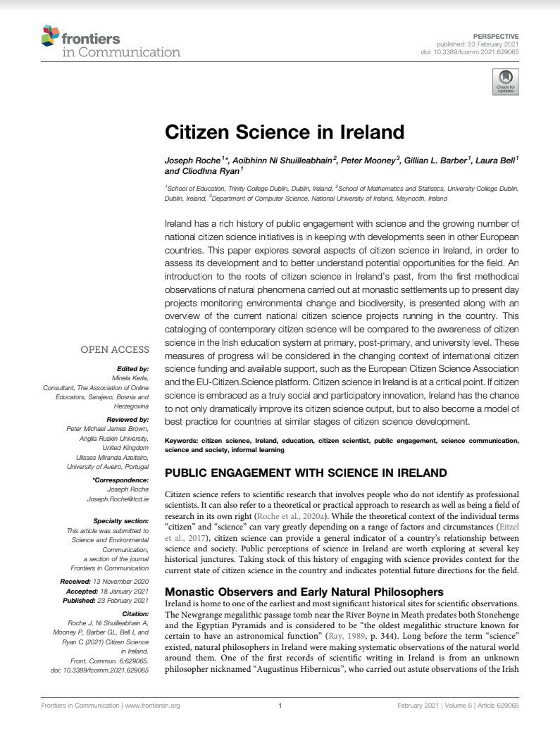
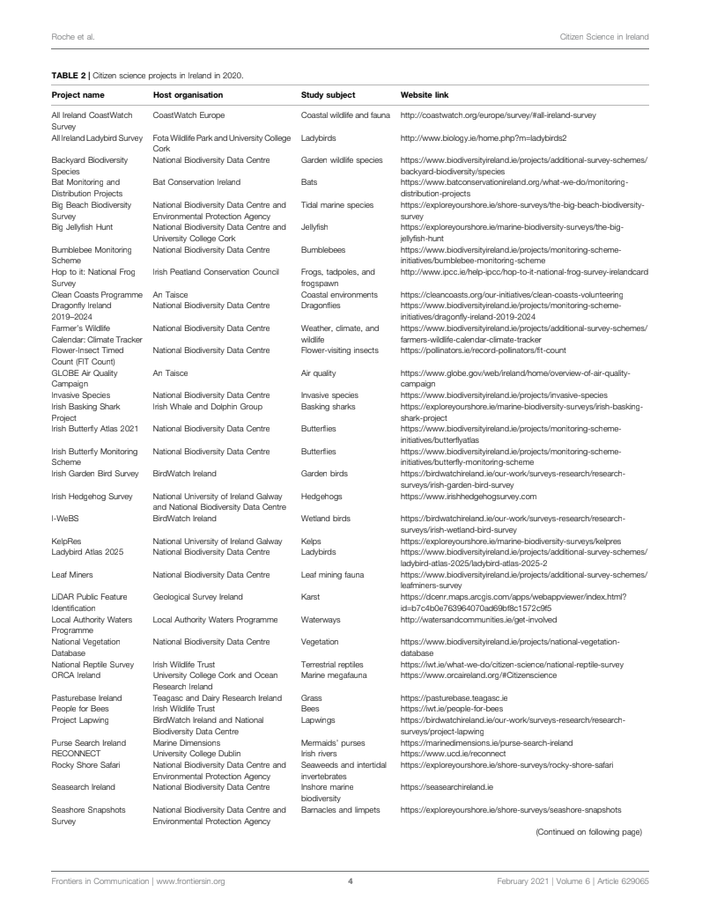
Roche, J., Ni Shuilleabhain, A., Mooney, P., Barber, G. L., Bell, L., & Ryan, C. (2021).
Citizen Science in Ireland. Frontiers in Communication, 6(629065), 1-8.

Slide 14
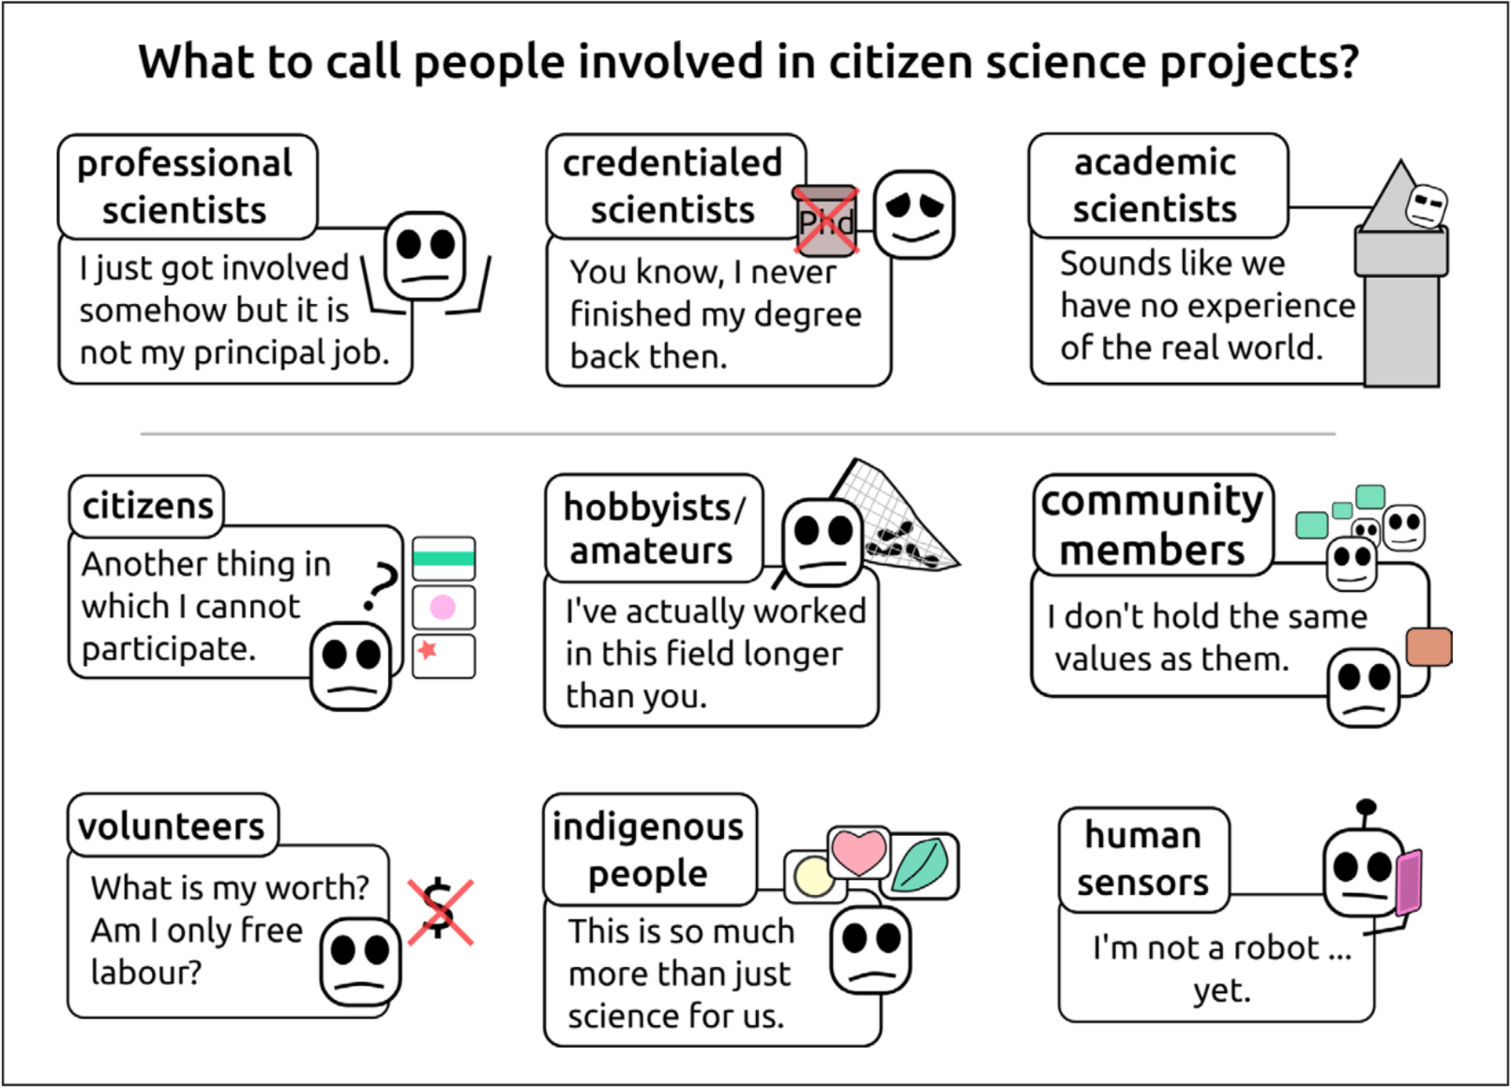
Eitzel, M. V., Cappadonna, J. L., Santos-Lang, C., Duerr, R. E., Virapongse, A., West, S. E., Kyba, C. C. M., Bowser, A.,
Cooper, C. B., Sforzi, A., Metcalfe, A. N., Harris, E. S., Thiel, M., Haklay, M., Ponciano, L., Roche, J., Ceccaroni, L.,
Shilling, F. M.,Dörler, D., Heigl, F., Kiessling, T., Davis, B. Y., Jiang, Q. (2017).
Citizen Science Terminology Matters: Exploring Key Terms. Citizen Science: Theory and Practice,
2(1), 1–20. https://doi.org/10.5334/cstp.96

Slide 15



Slide 16

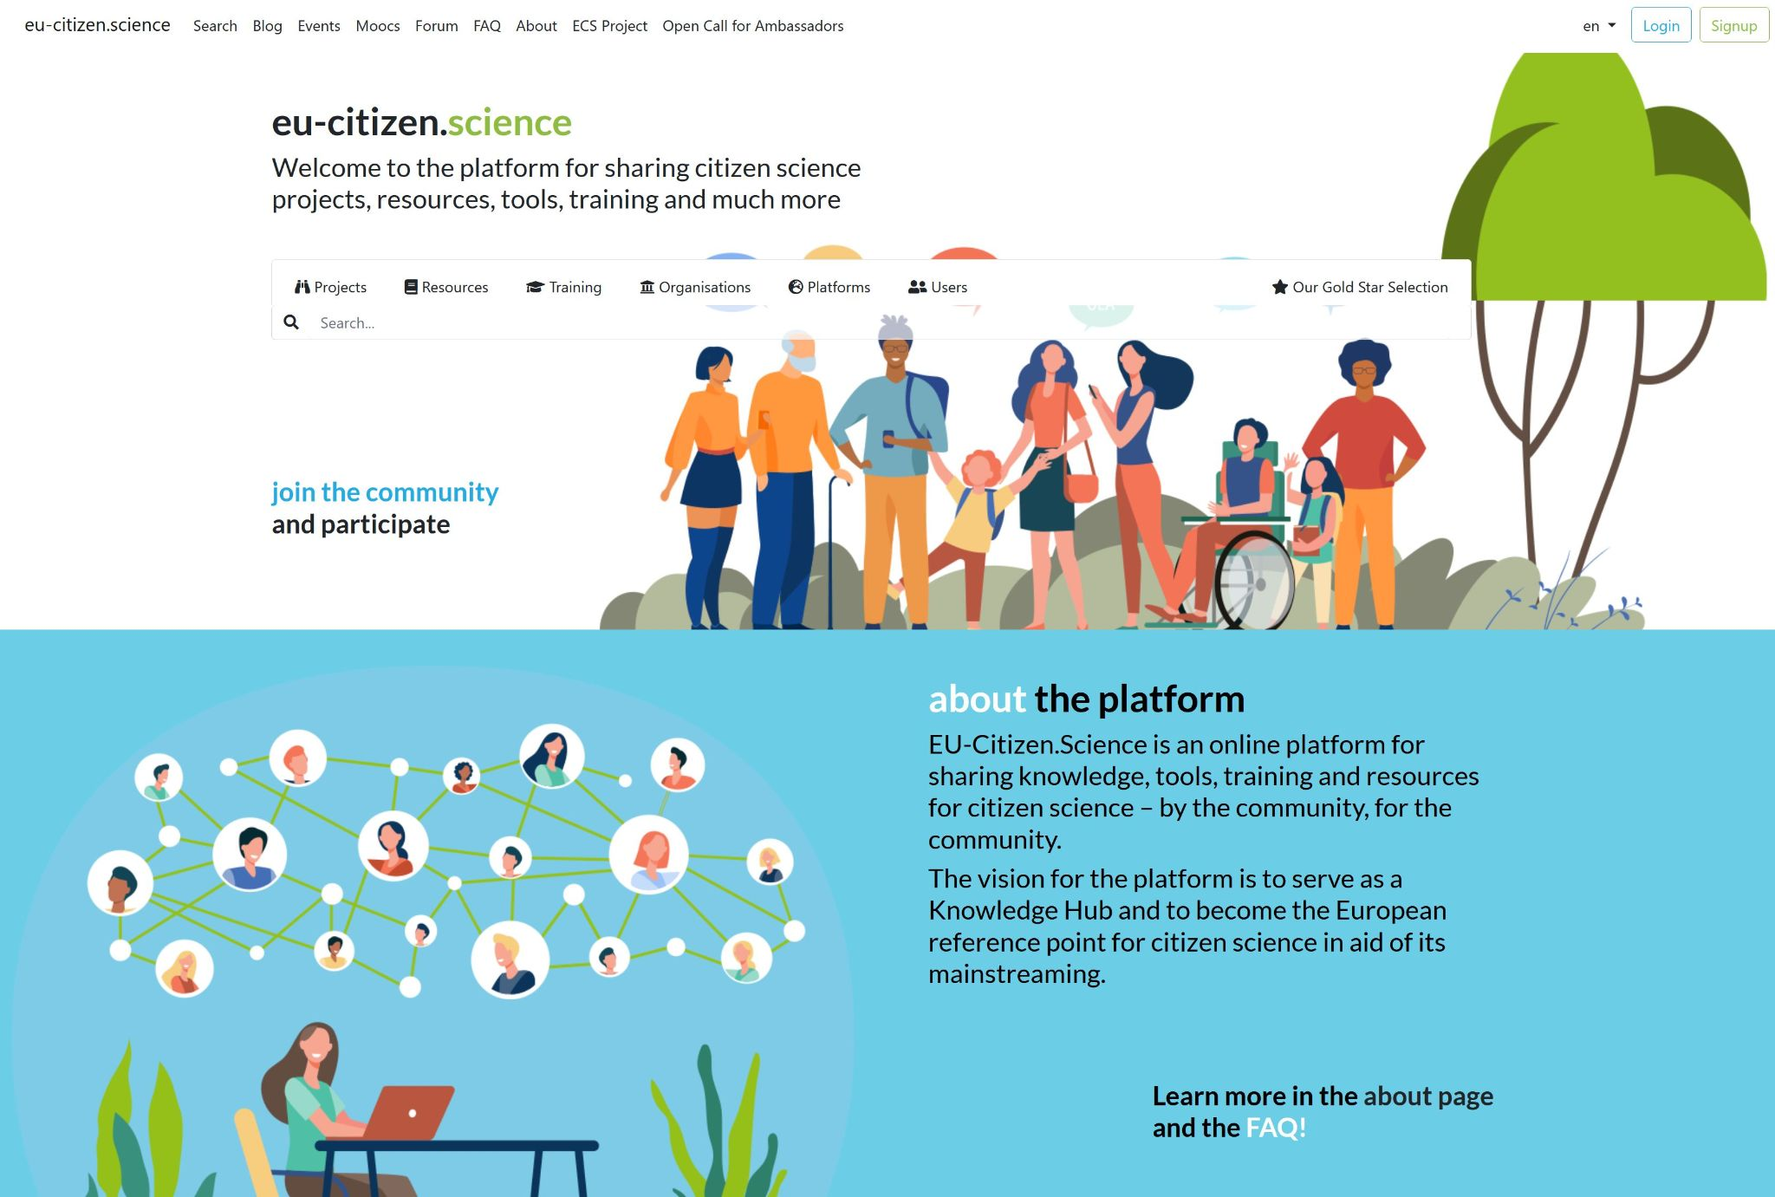



EU-Citizen.Science platform
Built during the EU-Citizen.Science project (2019-2021, H2020, Grant Agreement nr. 824580)
Enhanced and enlarged with new tools, services and resources, and connected to other (national) citizen science infrastructure in the ECS project
Built by and for the community – as a place to share knowledge, tools, training and resources for citizen science
Bundles information on citizen science bringing together the results and outcomes of many citizen science projects

Slide 17
citizenscience.eu
As of February 5th 2026:
442 projects
272 resources
92 training resources
378 organisation profiles
33 training modules
an events calendar and a blog
platform/network and user profiles
5,134 registered users

Slide 18
Citizen Science:
Causes for optimism

Slide 19
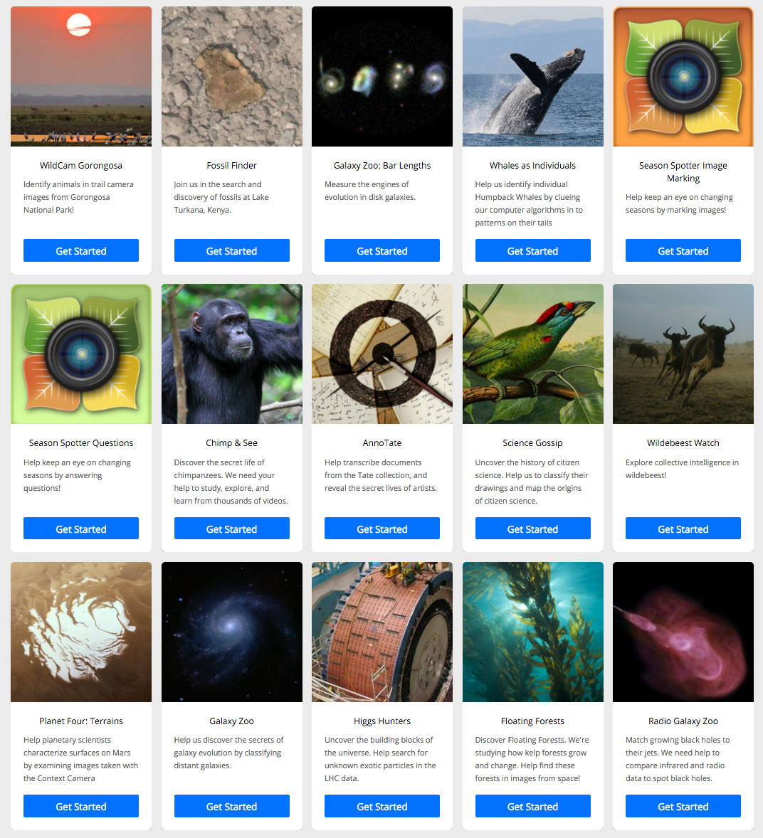
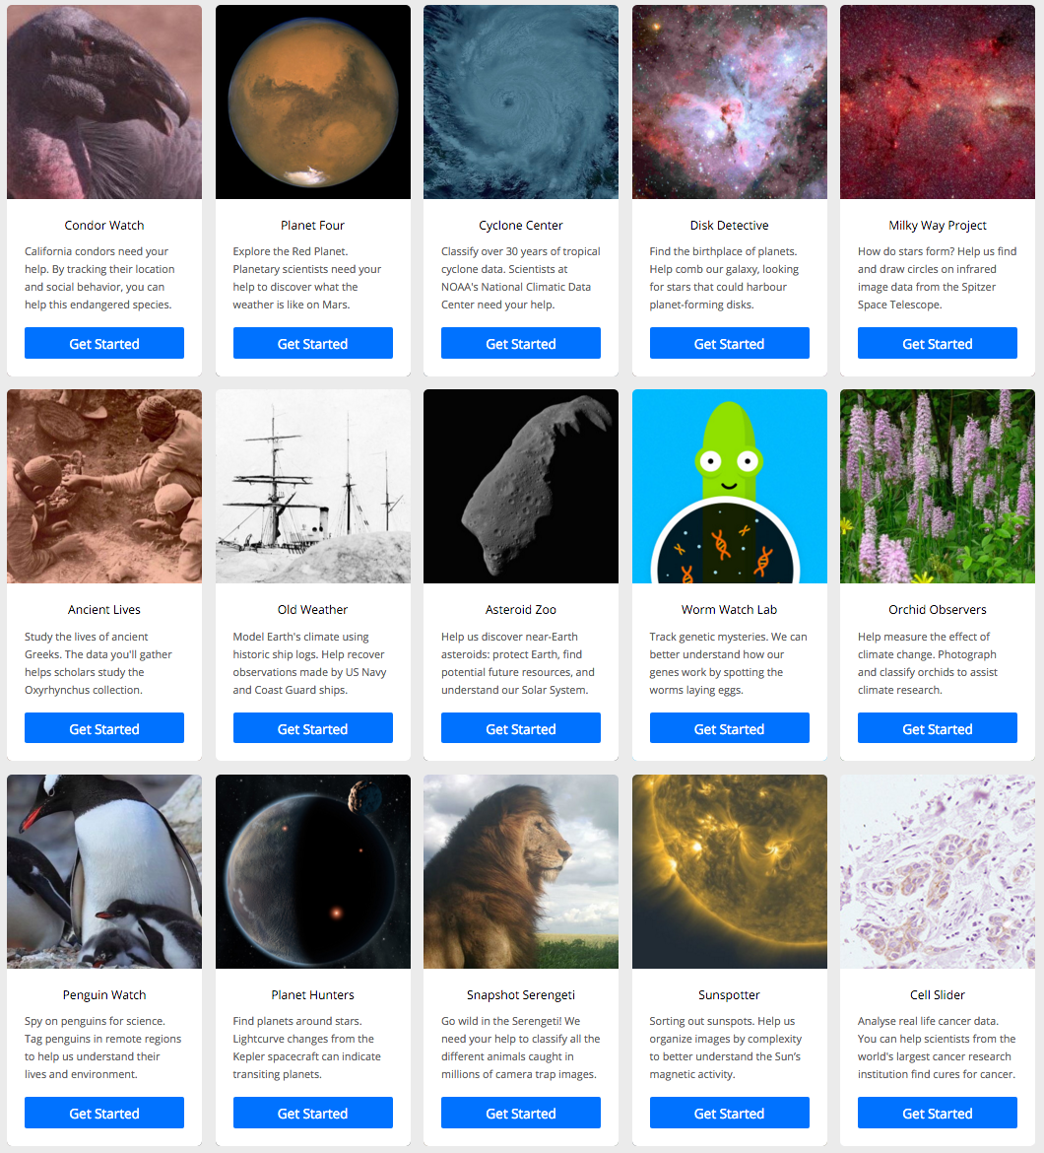

Slide 20
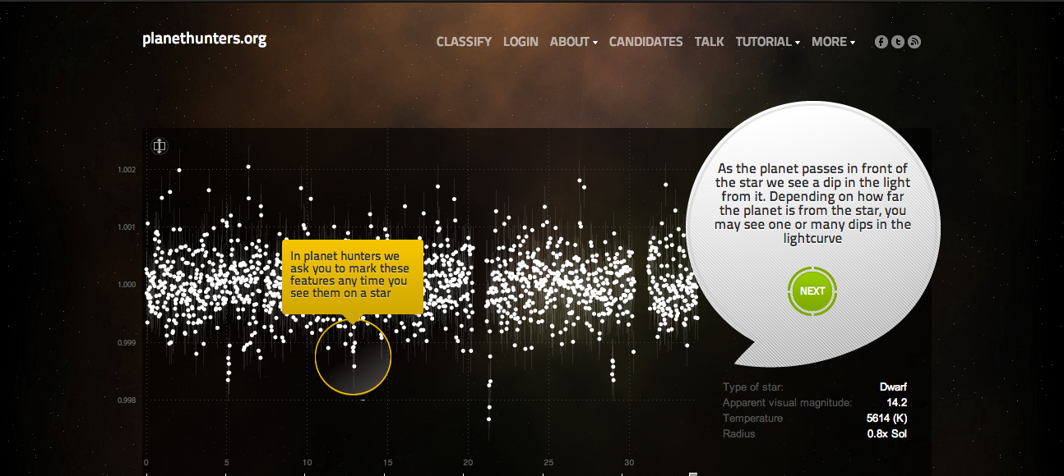

Slide 21
“In this paper, we discuss an unusual structure, colloquially known as ‘Hanny’s Voorwerp’ discovered by Hanny van Arkel in the vicinity of the spiral galaxy IC 2497” (p. 130)
Lintott, C. J., Schawinski, K., Keel, W., Van Arkel, H., Bennert, N., Edmondson, E., ... & Virani, S. (2009).
Galaxy Zoo:‘Hanny's Voorwerp’, a quasar light echo?.
Monthly Notices of the Royal Astronomical Society, 399(1), 129-140.
Notes:
Hanny's Voorwerp /ˈhʌn.nis ˈvɔːr.wɛrp/, (Dutch for Hanny's object) is a rare type of astronomical object called a quasar ionization echo.[1][2][3][4] It was discovered in 2007 by Dutch schoolteacher Hanny van Arkel, while she was participating as a volunteer in the Galaxy Zoo project. Photographically, it appears as a bright blob close to spiral galaxy IC 2497 in the constellation Leo Minor.

Slide 22
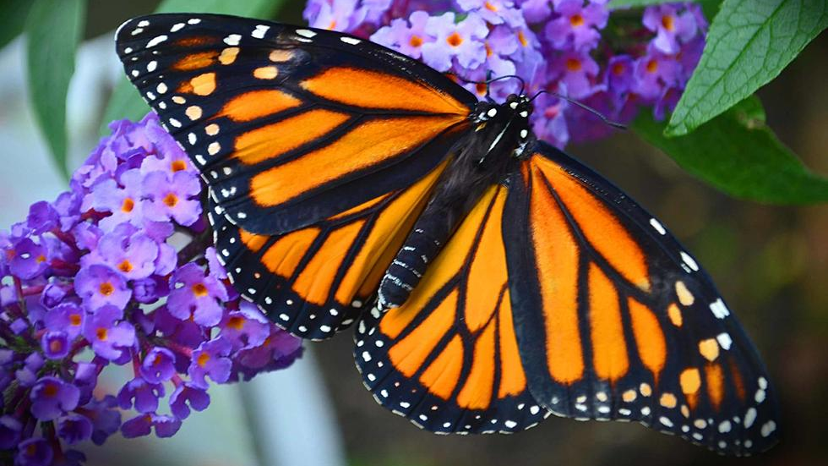
Notes:
Monarch butterfly… important because they act as pollinators and as they decline ecosystems suffer. Because they are so distinctive they are sometimes seen as the “canary in the coal mine” for damage to an ecosystem because their decline is usually noticed sooner than that of other pollinators. Their migratory patterns are also fascinating because they travel thousands of miles despite the fact that they weigh no more than a paperclip.

Slide 23
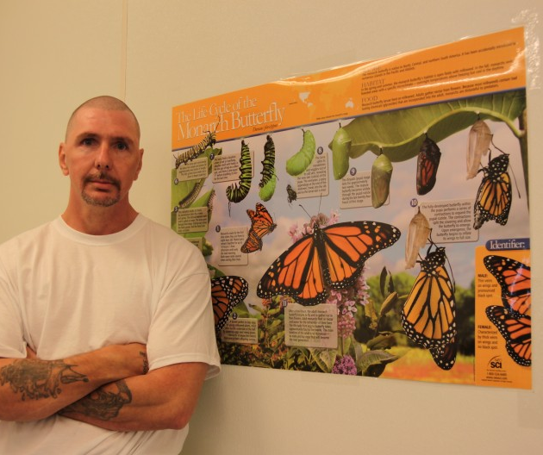
“The Butterfly Wranglers may appear to be double castaways, separated from society and other inmates, yet while their empathy toward fellow humans has suffered, they are often hesitant to enter the monarch program because they are afraid they will accidently hurt the caterpillars...” (p. 57).
“The Butterfly Wranglers, as they call themselves, have proven to be dedicated individuals, highly capable of rearing butterflies. In fact, they are better at growing monarchs than [...] the professional...” (p. 56).
Cooper, C. (2017).
Citizen science: How ordinary people are changing the face of discovery.
London: Duckworth Overlook.
Notes:
Entomologist David James studied Monarch Butterflies and had a difficult time breeding and tagging enough butterflies for him to be able to do his research. So he enlisted the help of inmates in Washington State Penitentiary.
“James teamed up with Tamara Russell, a psychologist and the clinical director at the Washington State Penitentiary, to entice prison inmates to raise monarchs. The Butterfly Wranglers, as they call themselves, have proven to be dedicated individuals, highly capable of rearing butterflies. In fact, they are better at growing monarchs than James”

Slide 24
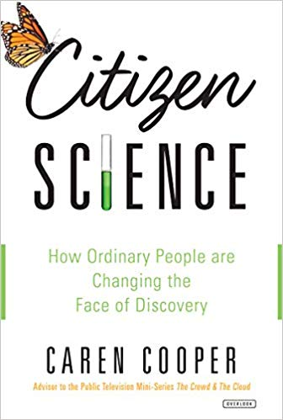
“Mules, mountains, and scientific establishments rank in the top three on the list of things that are nearly impossible to move.
Remember this — centuries of stubbornness — as we soon begin to consider how citizen science might reorganize the scientific establishment today.” (p.141)
Cooper, C. (2017).
Citizen science: How ordinary people are changing the face of discovery.
London: Duckworth Overlook.

Slide 25
Citizen Science:
Potential cause for concern

Slide 26
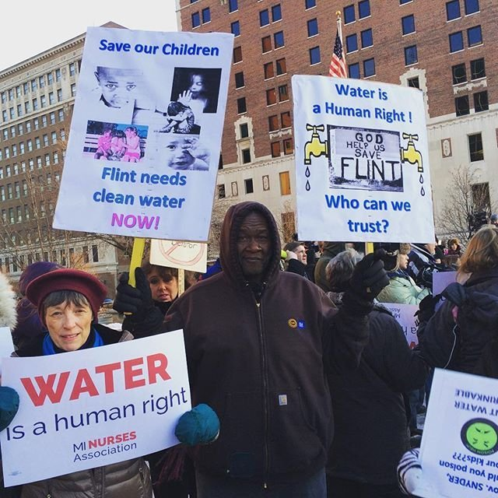
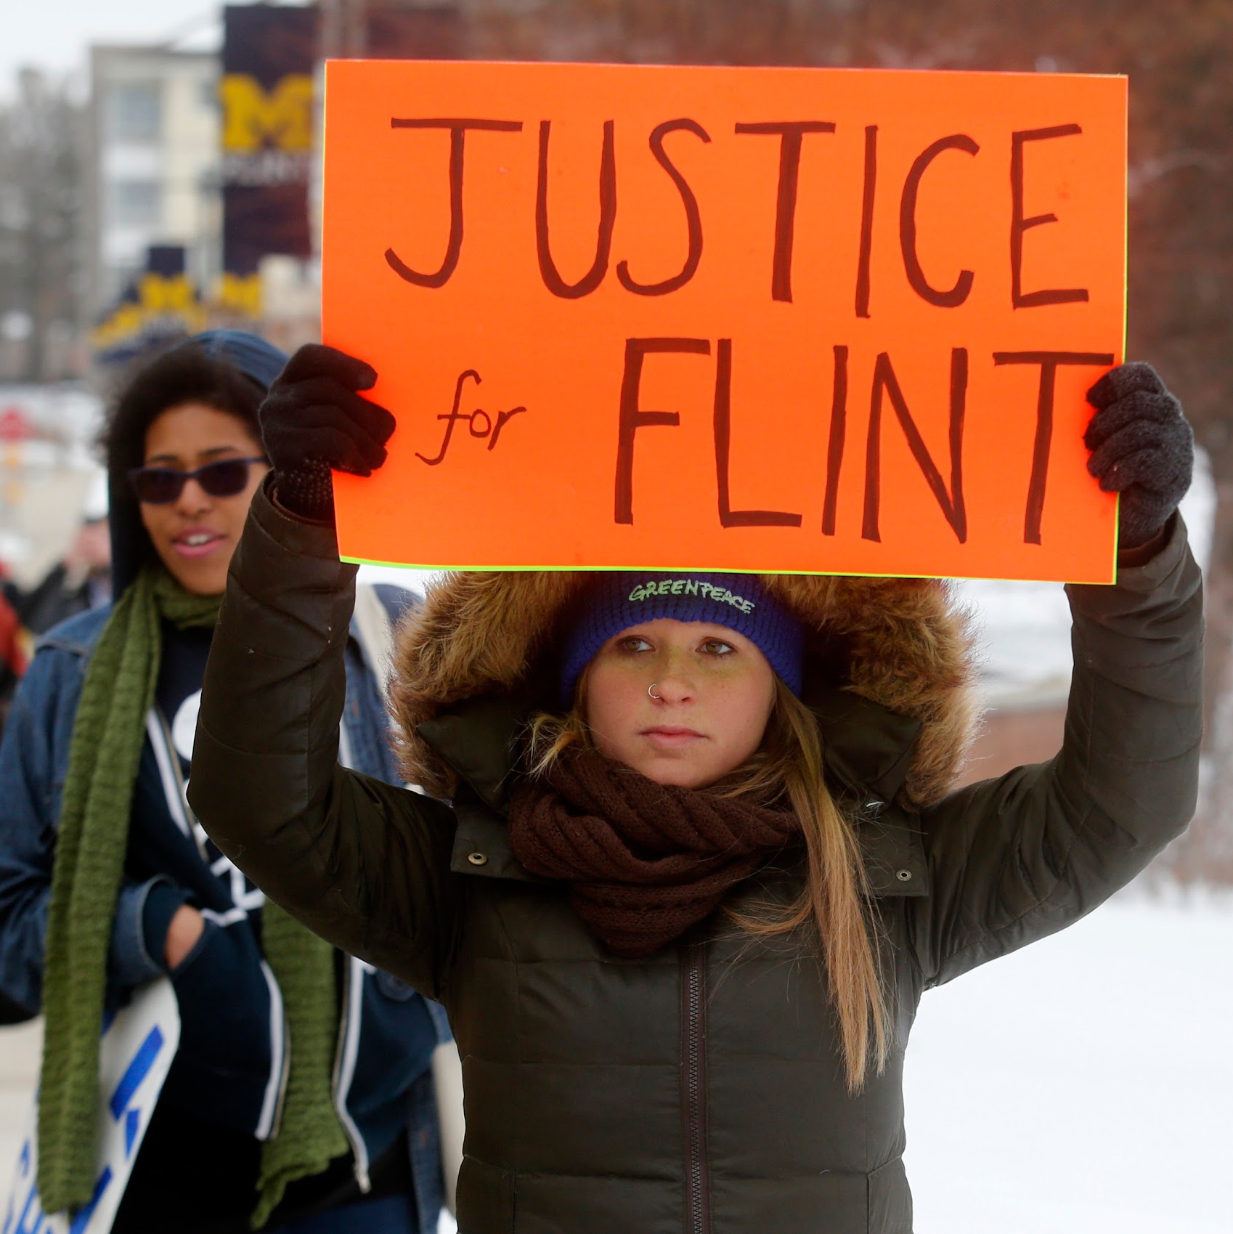

Slide 27
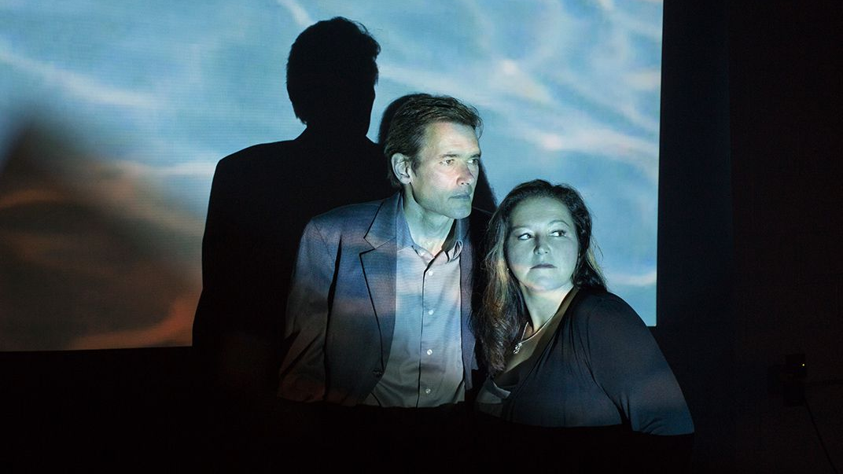

Slide 28
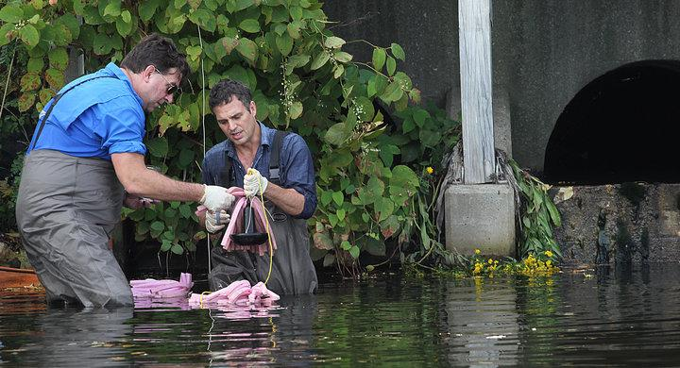
Notes:
https://www.huffingtonpost.com/entry/mark-ruffalo-flint_us_5741ebc7e4b0613b512a8d25

Slide 29
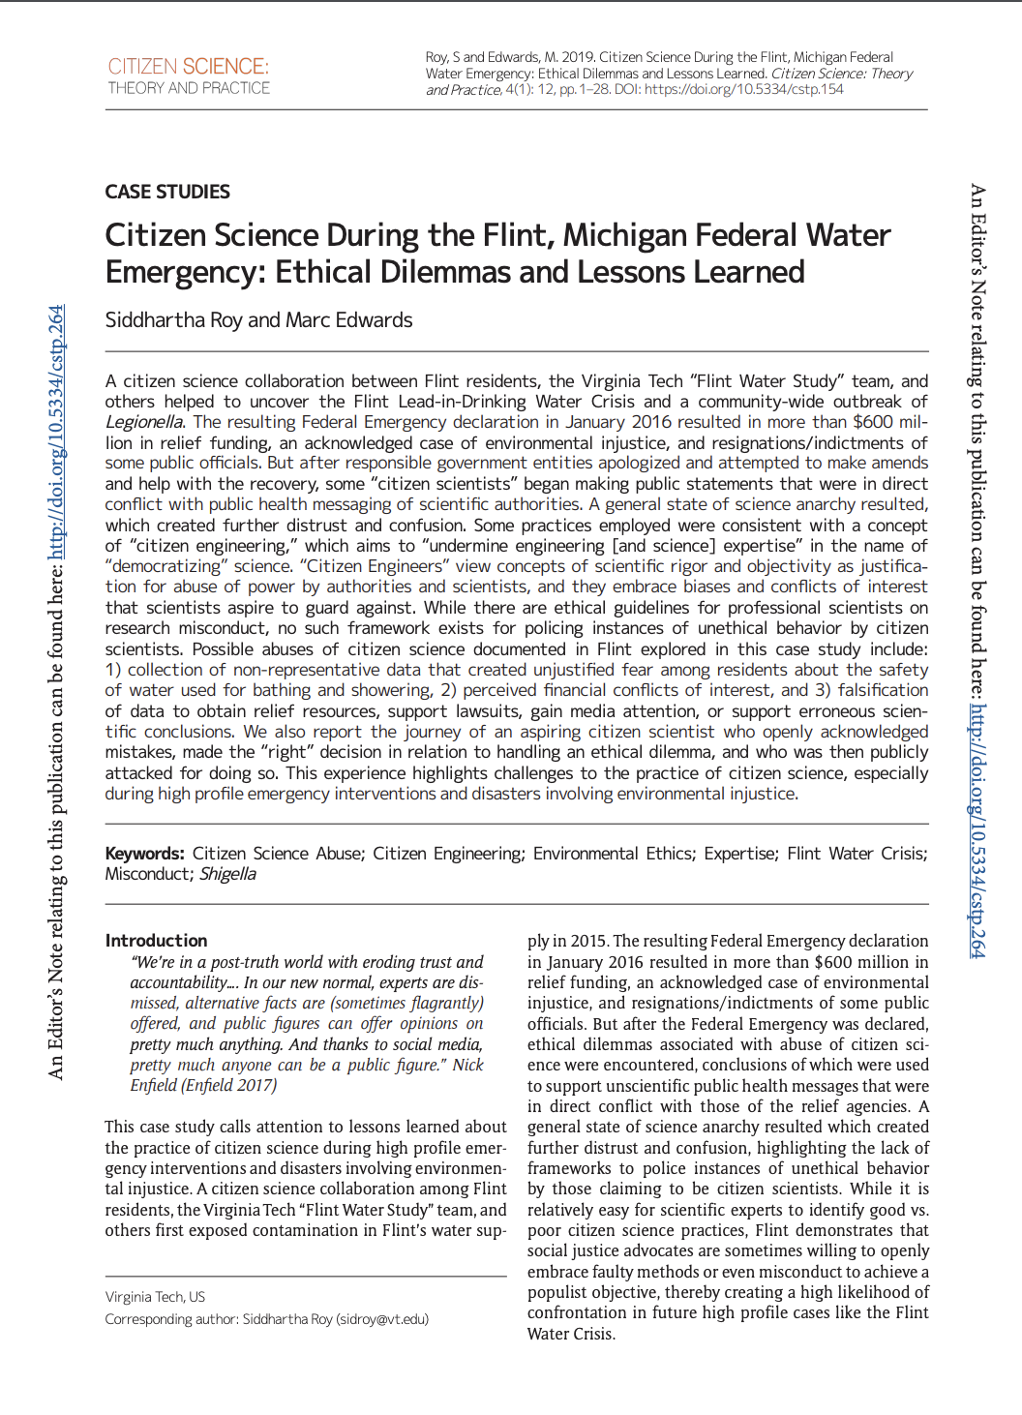
Roy, S., & Edwards, M. (2019).
Citizen Science During the Flint, Michigan Federal Water Emergency:
Ethical Dilemmas and Lessons Learned.
Citizen Science: Theory and Practice, 4(1), 1-28.

Slide 30
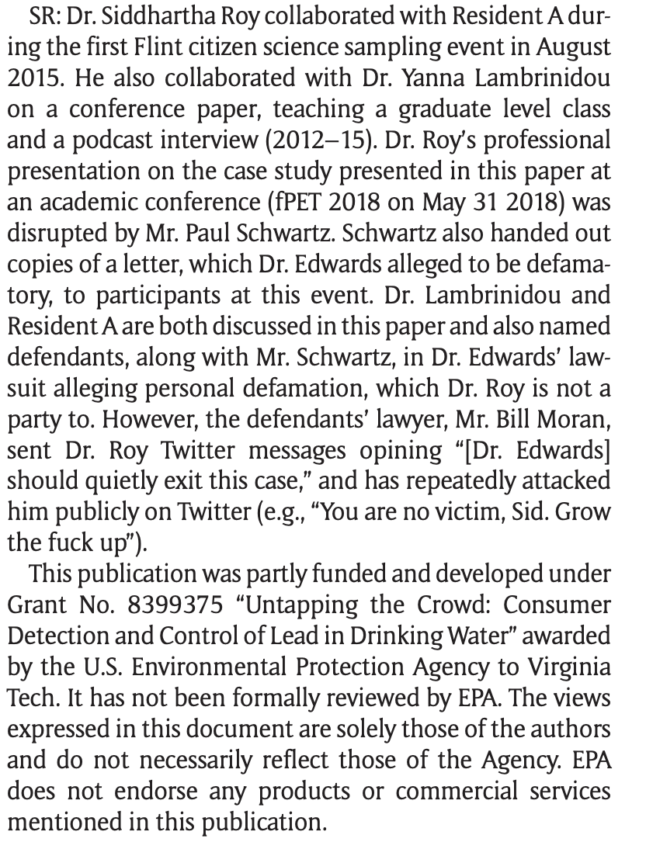
Roy, S., & Edwards, M. (2019).
Citizen Science During the Flint, Michigan Federal Water Emergency:
Ethical Dilemmas and Lessons Learned.
Citizen Science: Theory and Practice, 4(1), 1-28.

